Slide 1

______ Things _______
John 3: 1-10

Slide 2
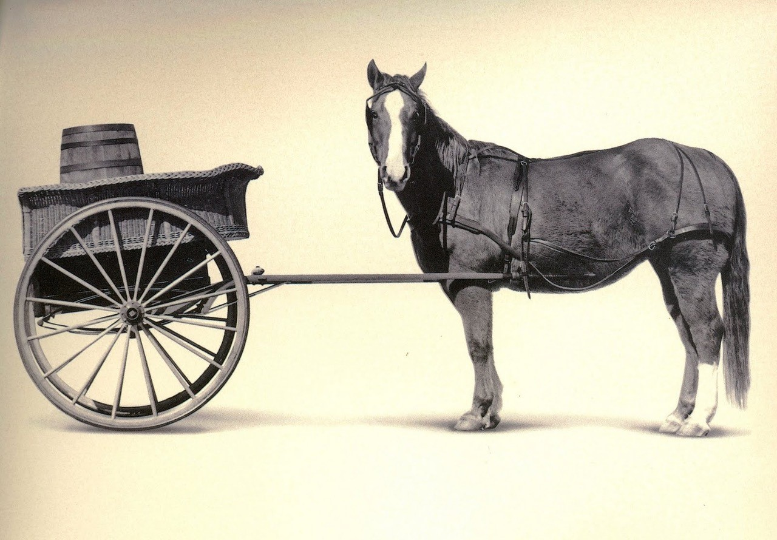


Slide 3
It’s easy to get the cart before the horse

Slide 4
Nicodemus is a perfect example

Slide 5
John 3: 1-10
Now there was a Pharisee, a man named Nicodemus who was a member of the Jewish ruling council. He came to Jesus at night and said, “Rabbi, we know that you are a teacher who has come from God.
For no one could perform the signs you are doing if God were not with him.”

Slide 6
Jesus replied, “Very truly I tell you, no one can see the kingdom of God unless they are born again.” “How can someone be born when they are old?” Nicodemus asked. “Surely they cannot enter a second time into their mother’s womb to be born!”
Jesus answered, “Very truly I tell you, no one can enter the kingdom of God unless they are born of water and the Spirit.

Slide 7
Flesh gives birth to flesh, but the Spirit gives birth to spirit. You should not be surprised at my saying, ‘You must be born again.’ The wind blows wherever it pleases. You hear its sound, but you cannot tell where it comes from or where it is going. So it is with everyone born of the Spirit.
“How can this be?” Nicodemus asked.
“You are Israel’s teacher,” said Jesus, “and do you not understand these things?

Slide 8
Nicodemus is a perfect example

Slide 9
If we want the New Life that Jesus’ death and resurrection makes possible, we have to begin by being born again.

Slide 10
Have you been born again?

Slide 11
Jesus explains that the new birth is
“of water and the Spirit”

Slide 12
“‘For I will take you out of the nations; I will gather you from all the countries and bring you back into your own land. I will sprinkle clean water on you, and you will be clean; I will cleanse you from all your impurities and from all your idols. I will give you a new heart and put a new spirit in you; I will remove from you your heart of stone and give you a heart of flesh. And I will put my Spirit in you and move you to follow my decrees and be careful to keep my laws.” --Ezekiel 36:24-27

Slide 13
So how is one born again?

Slide 14
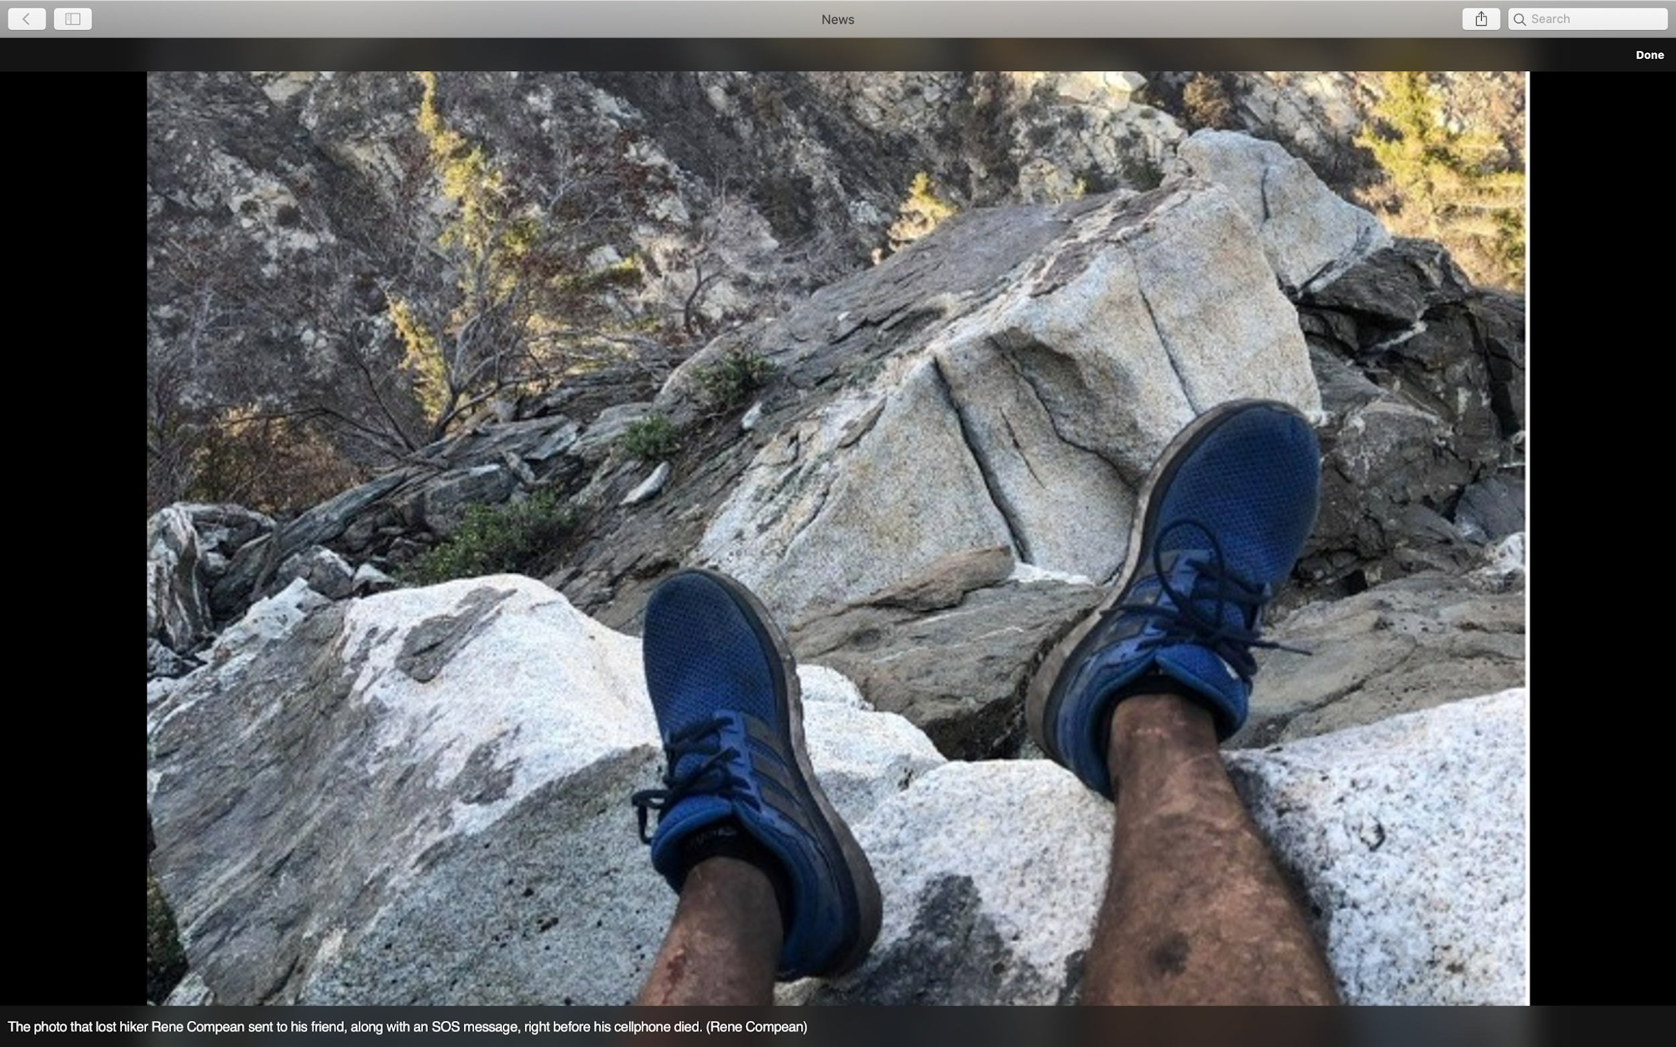

Slide 15
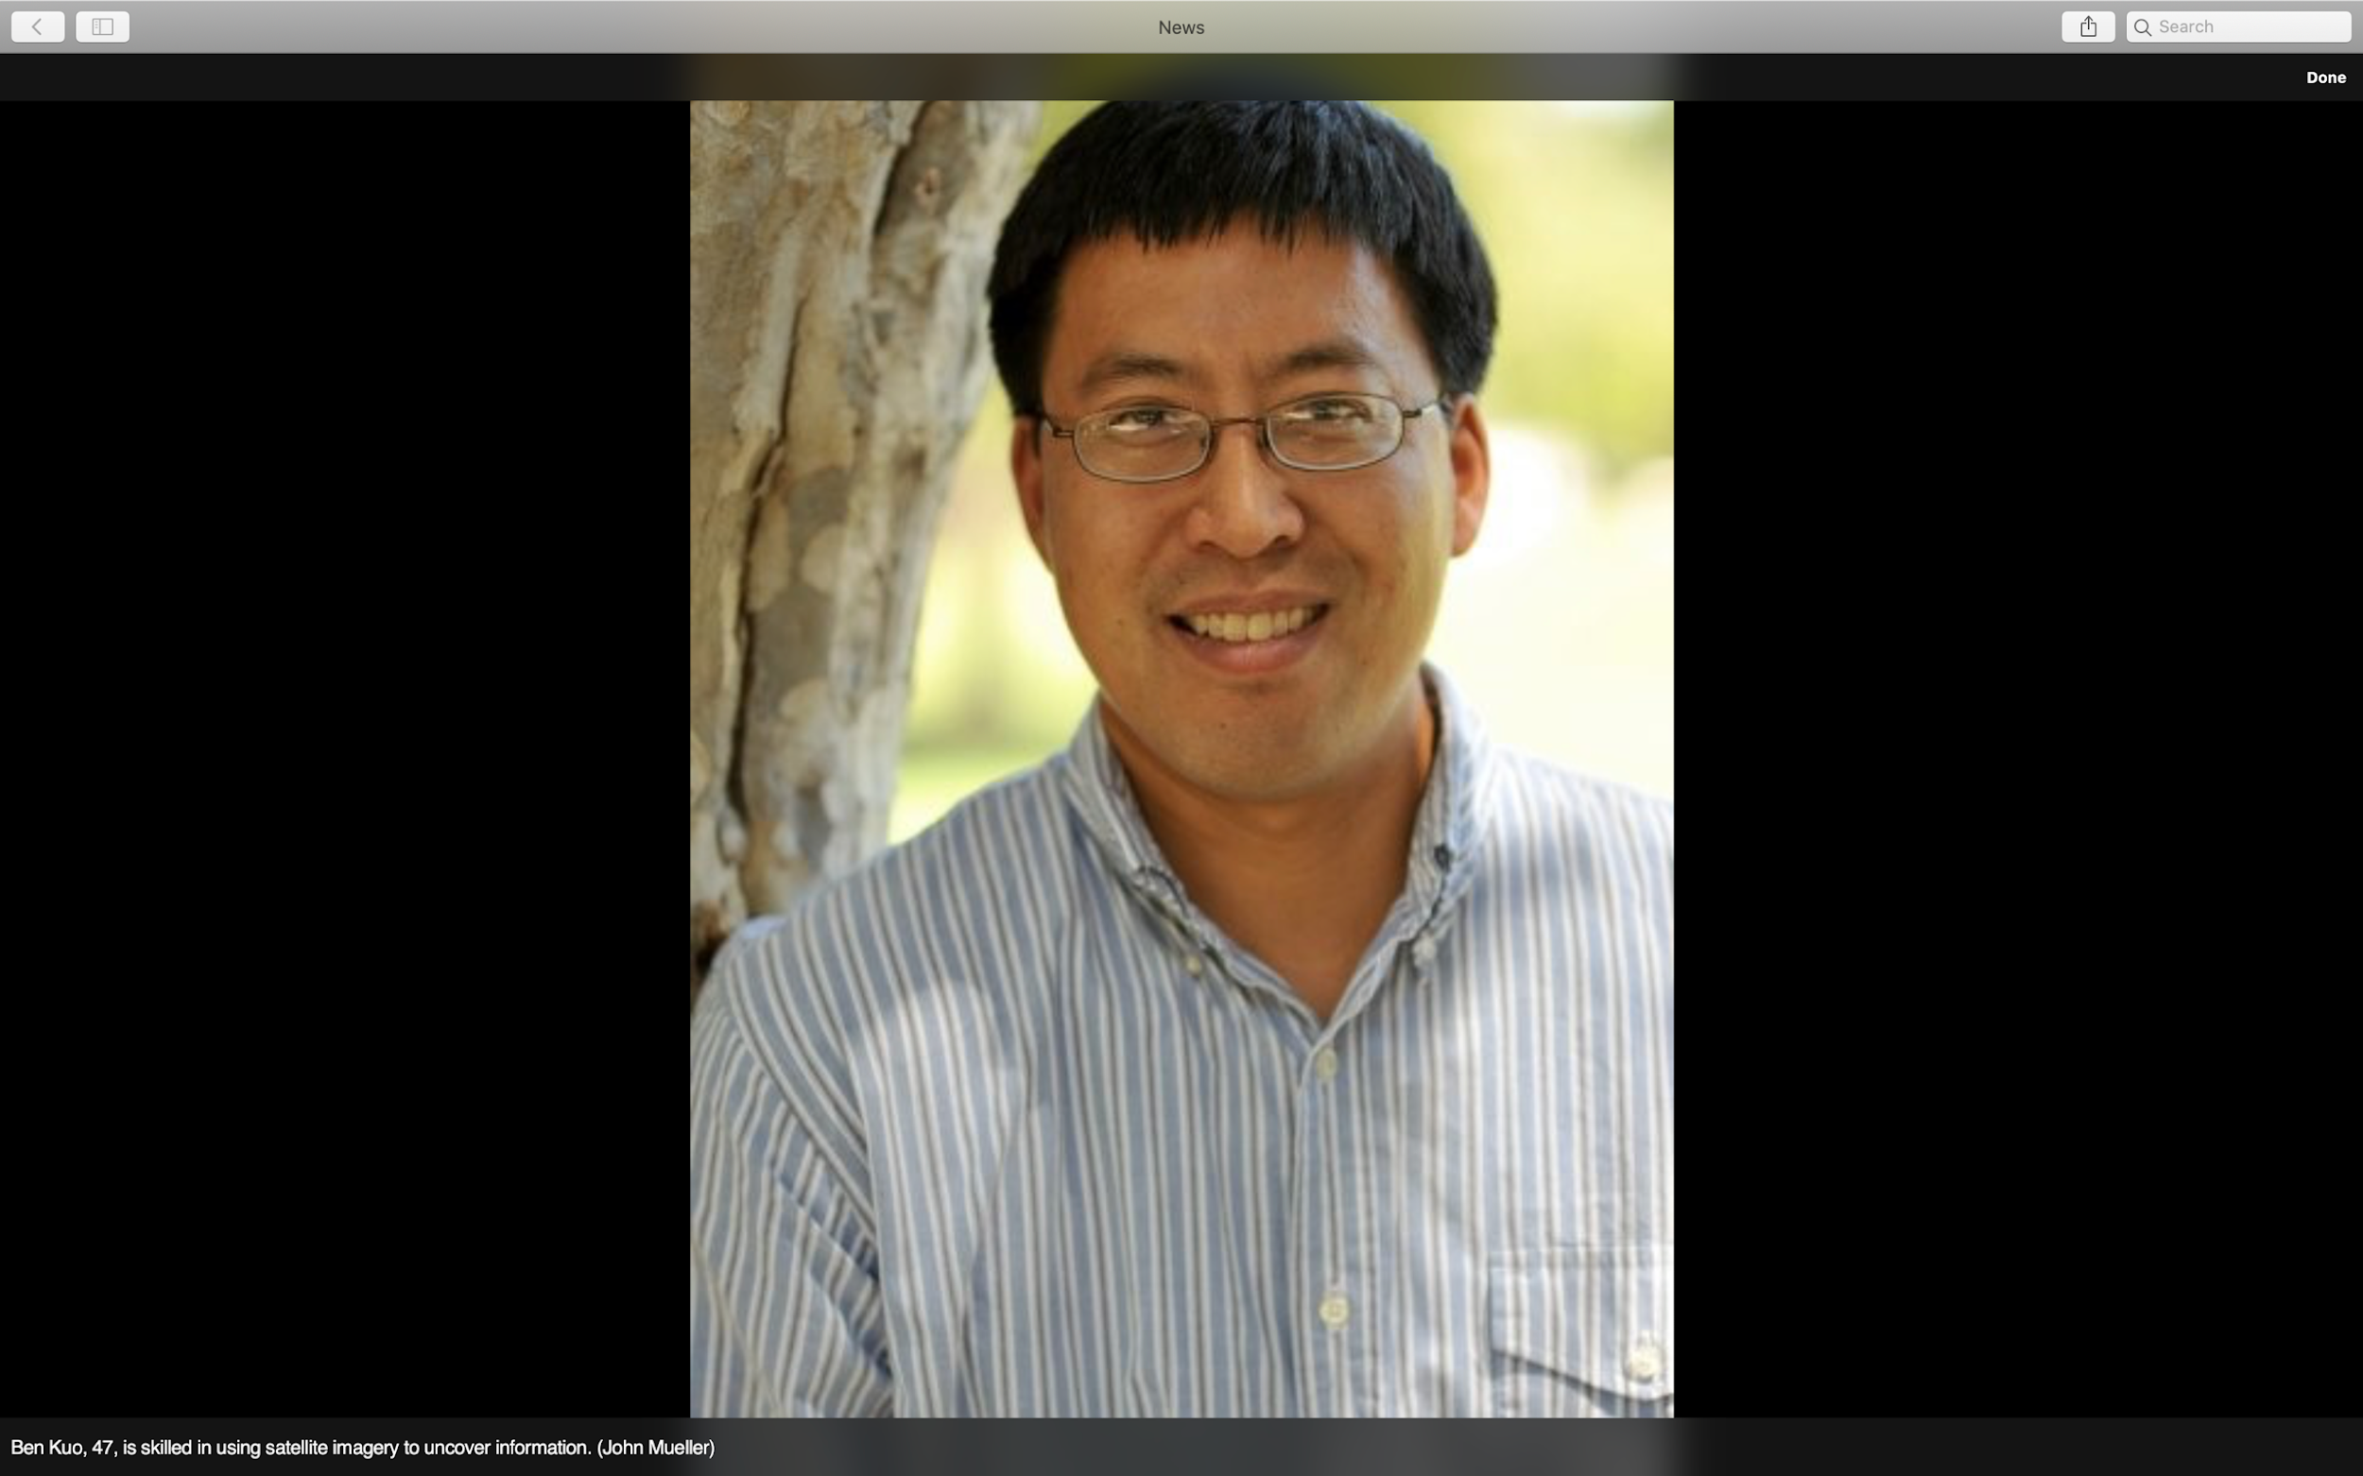

Slide 16
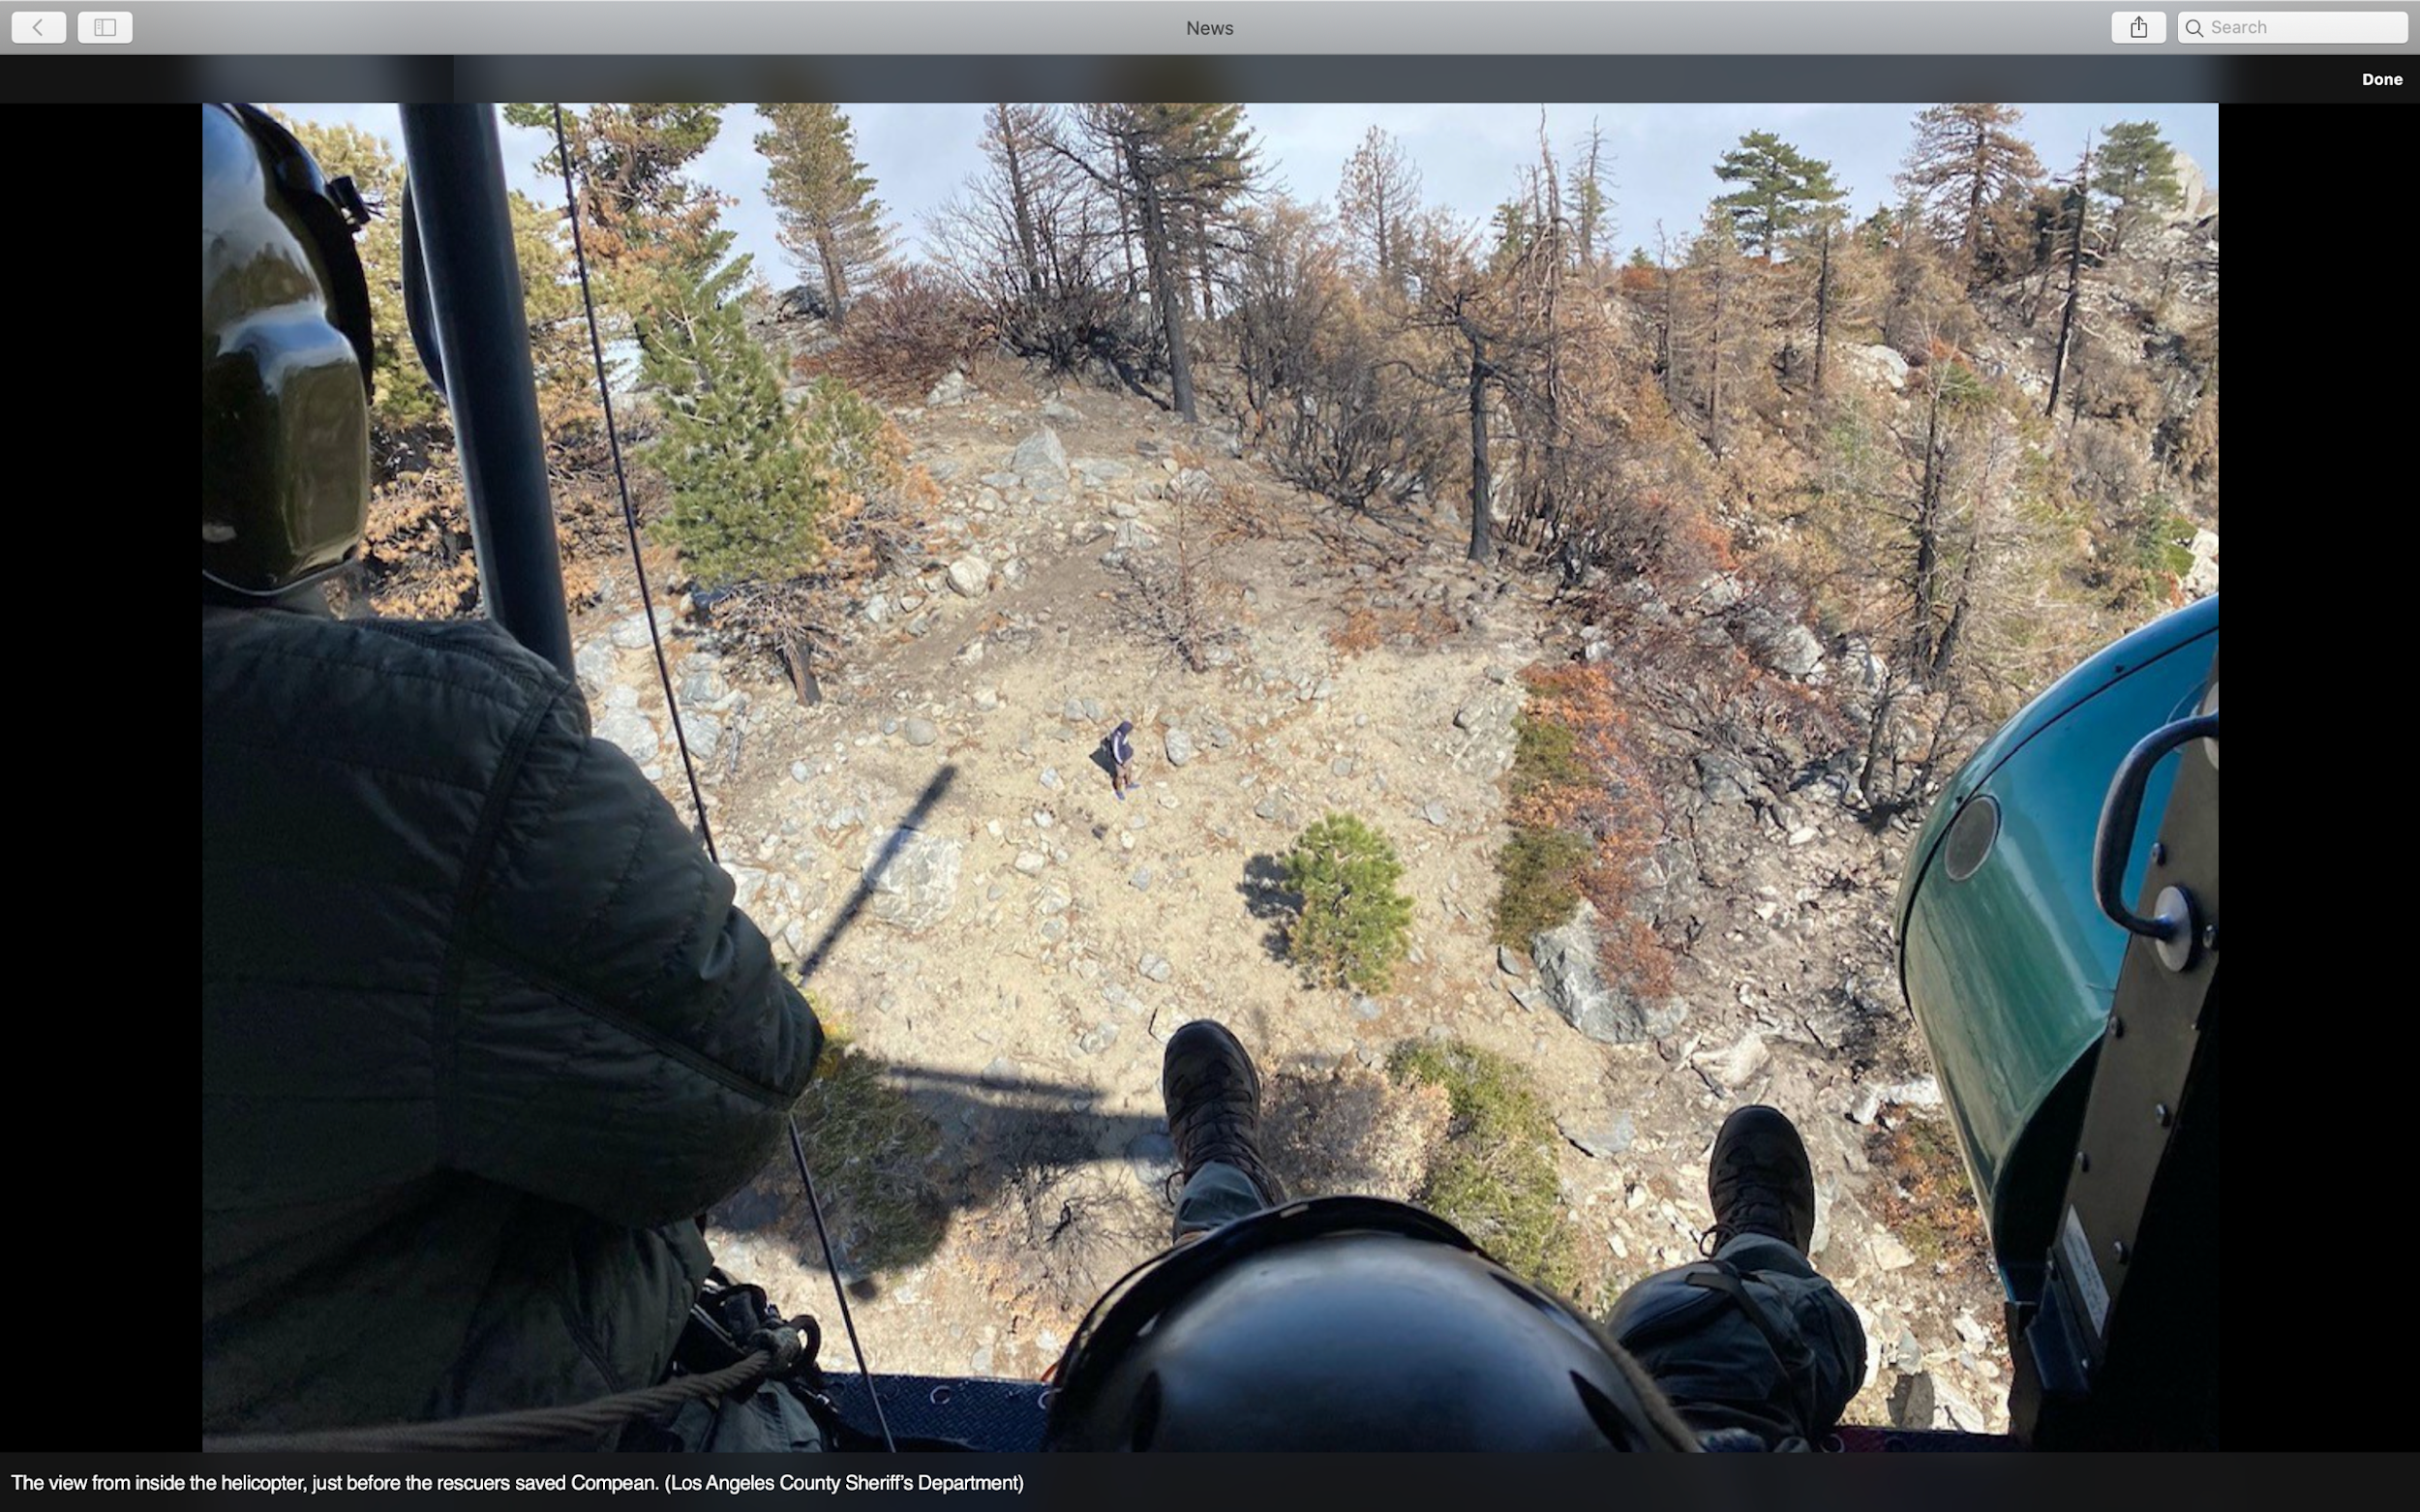

Slide 17
Jesus, I want the New Life that only you can offer. I’m turning from my own ways right now. I’m choosing to accept your grace and forgiveness in my life. I want to put first things first by asking you to change my heart right now. Please help me as I begin this New Life walking with you.
Text for Prayer: 913 214 9123

Slide 18
______ Things _______
John 3: 1-10

